Slide 1
PRESENTATION
PAK STUDIES
Education Minister
By
Muhammad Hassan Khalid (21L-5692)
Nimra Amer (21L-5609)
Farheen Akmal (21L-5666)
Muhammad Hamza (21L-5636)
Anam Umar (21L-5637)
Rabia Sajal Niazi (21L-5646)
Zenab Rizwan (21L-5640)
Muhammad Ahmad (21L-5617)
Mahad Sheikh (21L-5668)

Slide 2
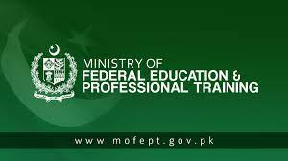
Ministry Of Federal Education And Professional Training
The ministry of federal education and professional training is a federal ministry of the Government of Pakistan
The ministry's political head is known as the education minister of Pakistan
Education is primarily provincial issue in Pakistan
In the wake of 18th amendment to the constitution of Pakistan when education department was transferred from federal to provinces
The ministry was established in July 2011

Slide 3

The Role Of The Ministry Of Education
Creating policies
Plans and programs to ensure the accessibility and availability of education in Pakistan
Provider of many technical, vocational and professional skills
Training that are needed to satisfy the national and international standards of the employment market
It works in collaboration with other ministries and organizations by sponsoring students
Distributing scholarships
Conducting multiple training sessions

Slide 4
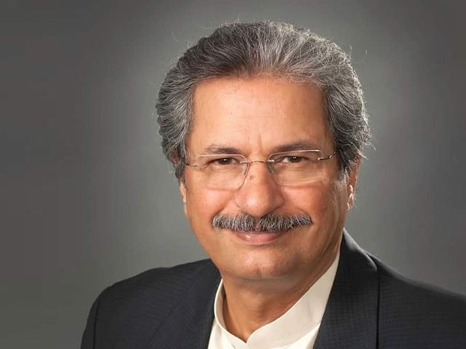
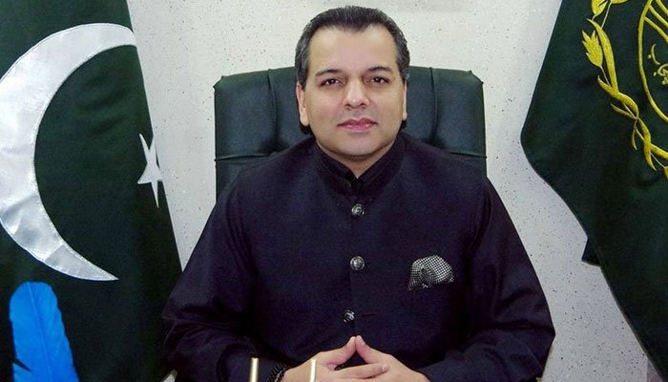
Federal Minister Of Education Shafqat Mahmood
Ministers Of Education
Murad Raas (Punjab)
Syed Sardar Ali Shah (Sindh)
Sardar Yar Muhammad Rind (Balochistan)
Mr. Shahram Khan Tarakai (Khyber Pakhtunkhwa)

Slide 5
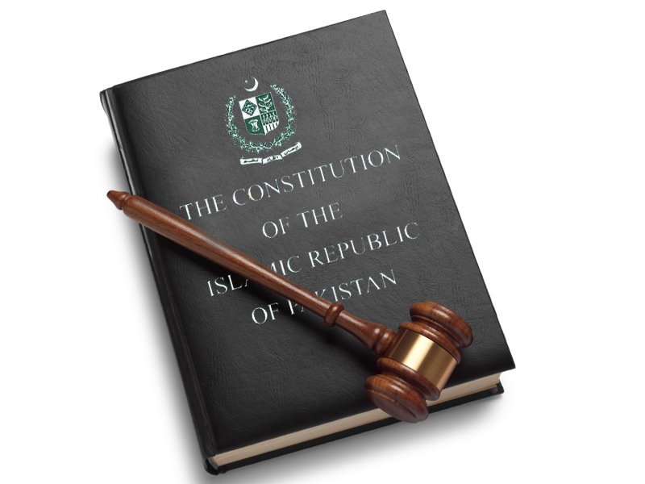
Constitution Of The Islamic Republic Of Pakistan The state of education in Pakistan has received a lot of criticism due to a lack of funds for education in the country, and an unequal distribution of Pakistan's education resources
What Rights Does Our Constitution Give Us
In 1959, a Commission on National Education was formed, which suggested that the educational system in Pakistan should pursue quality as an essential objective and recommended compulsory education for children.

Slide 6
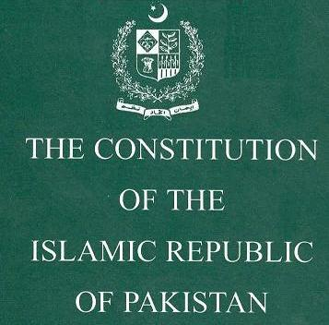
In 1973, Article 37-B of the Pakistani Constitution was created, stating that "The State shall remove illiteracy and provide free and compulsory secondary education within minimum possible period.
Also created in 1973 was Article 38-D of the Pakistani Constitution, which states "The State shall provide basic necessities of life, such as food, clothing, housing, education and medical relief, for all citizens, irrespective of sex, caste, creed or race, as are permanently or temporarily unable to earn their livelihood on account of infirmity, sickness or unemployment.“
In 2010, Article 25-A of the Pakistani Constitution was created, stating that "The State shall provide free and compulsory education to all children of the age of five to sixteen years in such manner as may be determined by law."

Slide 7
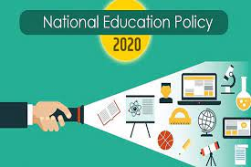
National Skills for all Strategy
. It envisions provision of relevant skills for industrial and economic development, improvement of access, equity and employability and assurance of quality through an integrated approach.
NATIONAL EDUCATION POLICY FRAMEWORK 2018
Enrolling 25 million out of school children, provision of quality education, skill development and uniformed syllabus across the country
Technical and Vocational Education and Training (TVET-2018) Policy for Pakistan
TVET is seen as an integral element to achieve relevant objectives set under Vision 2025, which is key government policy document for macroeconomic development of the country

Slide 8
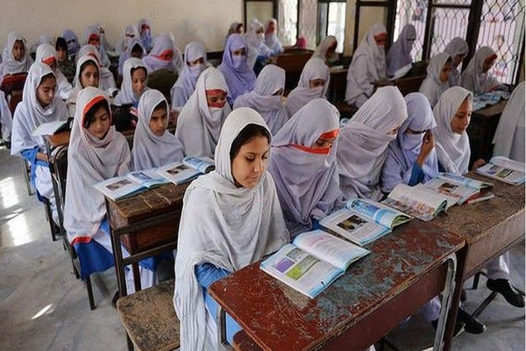
Draft National Education Policy 2017
The educational institutions nationalized for around 35 years should be provided with adequate compensatory funds to enhance their capacity and operations.
Quran Bill
Compulsory Teaching of the Holy Quran Bill 2017, which will make Quranic education compulsory for Grade 1 through Grade 12 in all federal educational institutions in the country.
National Curriculum Framework (NCF)
Policy document which provides guidelines for achieving national Vision, Mission, Goals and Objectives of education through school curricula.
National Education Policy 2009
To provide and ensure equal educational opportunities to all the citizens of Pakistan

Slide 9

LOOP HOLES IN OUR EDUCATION SYSTEM

Slide 10
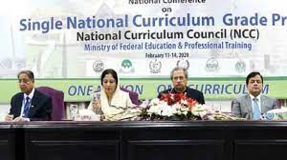
Single National Curriculum (SNC)
Children have a fair and equal opportunity to receive high quality education.
One system of Education for all, in terms of curriculum, medium of instruction and a common platform of assessment which will ensure:
All children have a fair and equal opportunity to receive high quality education
Equal opportunities for everyone
Equity in education

Slide 11
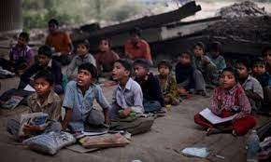
Ignorance of the Poor Children. In our system, the government schools are believed to be made for children with poor background only! And the condition of these schools is also like that only. The teachers of the government schools do not even care to come to the school regularly.
The problems associated with the education system of Pakistan are lack of adequate budget, lack of policy implementation, defective examination system, poor physical facilities, lack of teacher quality, lack of implementation of education policies, directionless education, low enrollment, high scale dropouts, political.

Slide 12

The directionless system of education is producing forces of degree holders who are deficient in high order live skills such as reflection, critical thinking, analysis, research and creativity.
Rattalization (Cramming):
Students are taught to do “Ratta” of the questions and answer without any concept and just paste that Ratta in the paper to pass the exam. It is because students don't understand the English language and they are taught everything in English.
No skills are being taught to students.

Slide 13
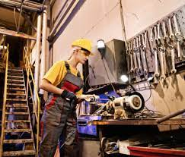
What Changes could be made to our education policies?
Upgradation of Books
Let children determine their field and let them enhance in that field
Establish More Schools
Build technical and vocational institutions
Encourage Sports sector
Work on school infrastructure

Slide 14

Technical education should be made a part of secondary education.
Providing economic incentives to the students may encourage the parents to send their children to school and may help in reducing the dropout ratio.
Better Standards
More Accountability
Parent Involvement
Adapt to New Technologies
Curriculum Revision
Periodic Assessments

